Slide 1
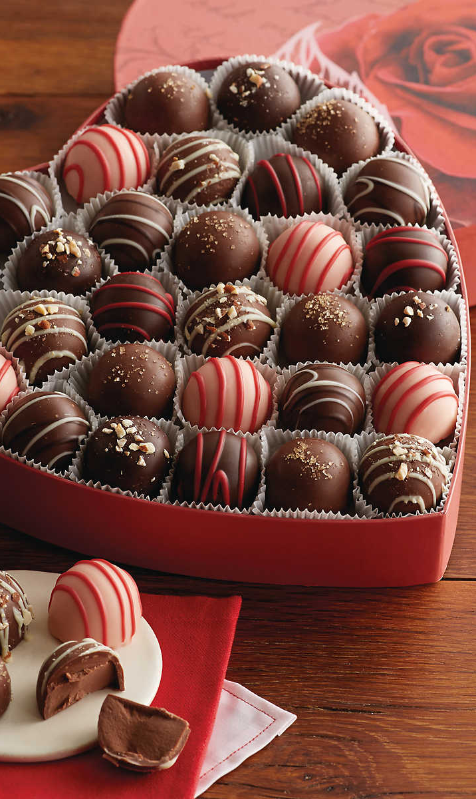
Valentine’s Incentive
NOTE:
To change images on this slide, select a picture and delete it. Then click the Insert Picture icon
in the placeholder to insert your own image.
By: Student A & B

Slide 2

Win a Box of Chocolates
NOTE:
To change images on this slide, select a picture and delete it. Then click the Insert Picture icon
in te placeholder to insert your own image.
In the Magi Market Feb. 03-13
Stop in for Details
Drawing on Valentines Day at 8:00 a.m.

Slide 3

Social Media Ad
We would post our flier on social media platforms like Snapchat, Facebook, Instagram, and twitter. This ad would include our promotion and the dates of the promotion.
Stop into the
Magi Market
Feb 3 – 13
for a chance to win Godiva chocolates! One drawing entry when you purchase 2 bags of chips!!!

Slide 4

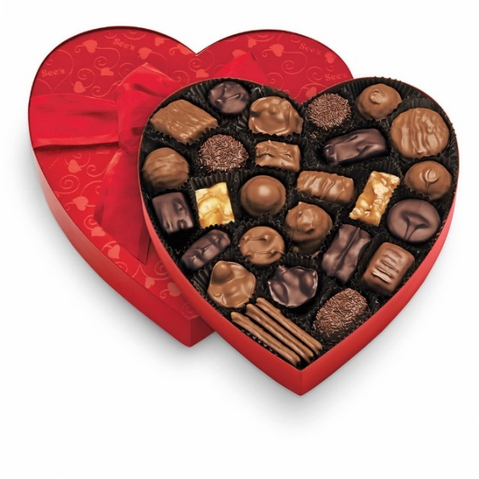
Fliers Ad
Win Godiva Chocolates for
someone special!
Our Second ad will be a flier handed out in the school store. When you purchase any product in the school store you are given a flier that has information about our upcoming promotion. (or create a poster)
Come into the store Feb. 3-13 for a chance to win a box of chocolates (a $32.00 value). One drawing entry each time you purchase two bags of chips!!!

Slide 5
Cost of our Promotion
Total Cost is $32.00
Keep the “Keep this coupon”
Print your name on the back of “Ticket” and put in box.
No profit unless we sell to 45 students
Only a $32 loss if not successful
If we sell 2 bags of chips to 45 students, we will break even.

